Slide 1
https://www.ncbi.nlm.nih.gov/pmc/articles/PMC7044178/
Environmental and Health Impacts of Air Pollution: A review

Slide 2
Air Pollutants:
Nitrogen Oxide
Sulfur Dioxide
Volatile Organic Compounds (VOC)
Dioxins and Polycyclic aromatic Hydrocarbons (PAHs)
Carbon monoxide
Heavy Metals
Diseases:
Chronic Obstructive Pulmonary Disease (COPD)
Asthma
Bronchiolitis
Lung Cancer
Cardiovascular events
Central Nervous system dysfunctions,
Cutaneous diseases

Slide 3
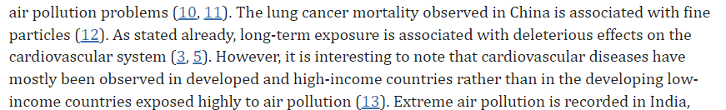
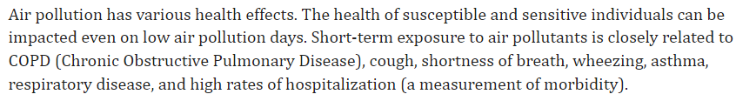
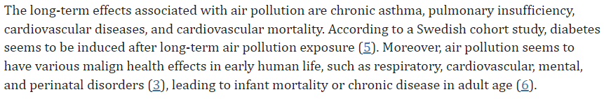
Anthropogenic air pollution is one of the biggest public health hazards worldwide, given that it accounts for about 9 million deaths per year (1).

Slide 4
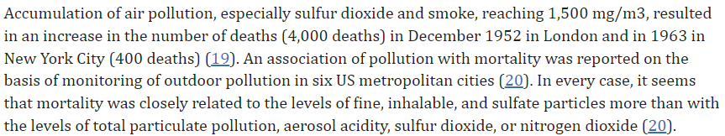
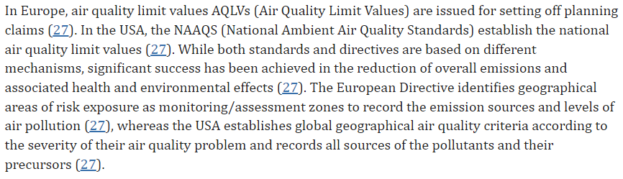

Slide 5
Classification based on Air Pollution sources:
Classification based on recipient of pollution
Air Pollution:
Air pollution is determined as the presence of pollutants in the air in large quantities for long periods. Air pollutants are dispersed particles, hydrocarbons, CO, CO2, NO, NO2, SO3, etc.
Major Sources:
Power stations, Refineries, Petrochemicals, Chemical and fertilizer industries, Metallurgical and industrial plants
Water Pollution:
Water pollution is organic and inorganic charge and biological charge (10) at high levels that affect the water quality (34, 35)..
Indoor Area Sources:
Domestic dry cleaning activities, Dry Cleaners, Printing shops, and Petrol stations
Mobile Sources:
Automobiles, Cars, Railways, Airways, and other types of vehicles.
Soil Pollution:
Soil pollution occurs through the release of chemicals or the disposal of wastes, such as heavy metals, hydrocarbons, and pesticides.
Natural Sources:
Forest Fires, Volcanic Eruption, dust storms,

Slide 6
Classification based on type of origin
Radioactive and nuclear pollution:
releasing radioactive and nuclear pollutants into water, air, and soil during nuclear explosions and accidents, from nuclear weapons, and through handling or disposal of radioactive sewage.
Noise pollution is produced by machines, vehicles, traffic noises, and musical installations that are harmful to our hearing.
Mobile Sources:
Environmental pollution occurs when changes in the physical, chemical, or biological constituents of the environment (air masses, temperature, climate, etc.) are produced.
Natural Sources:
Forest Fires, Volcanic Eruption, dust storms,

Slide 8
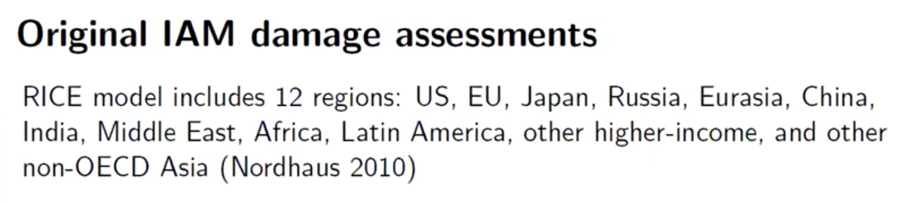

Slide 9
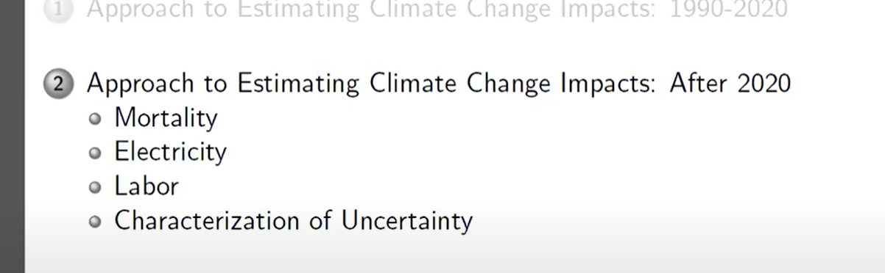

Slide 10
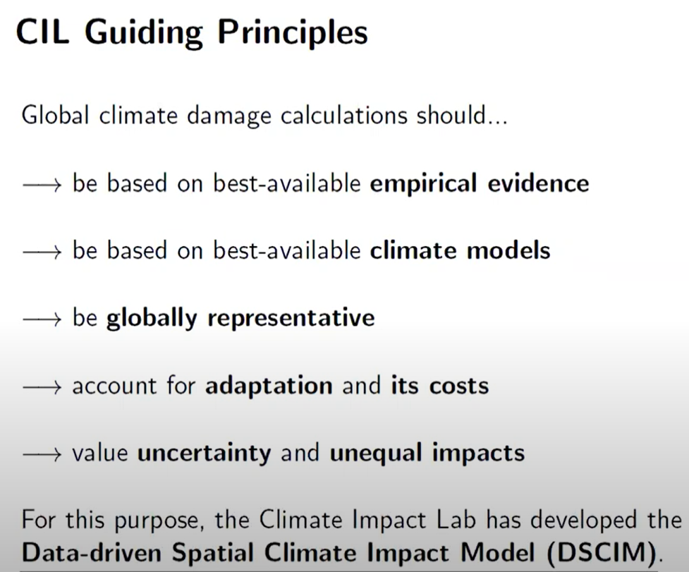

Slide 11
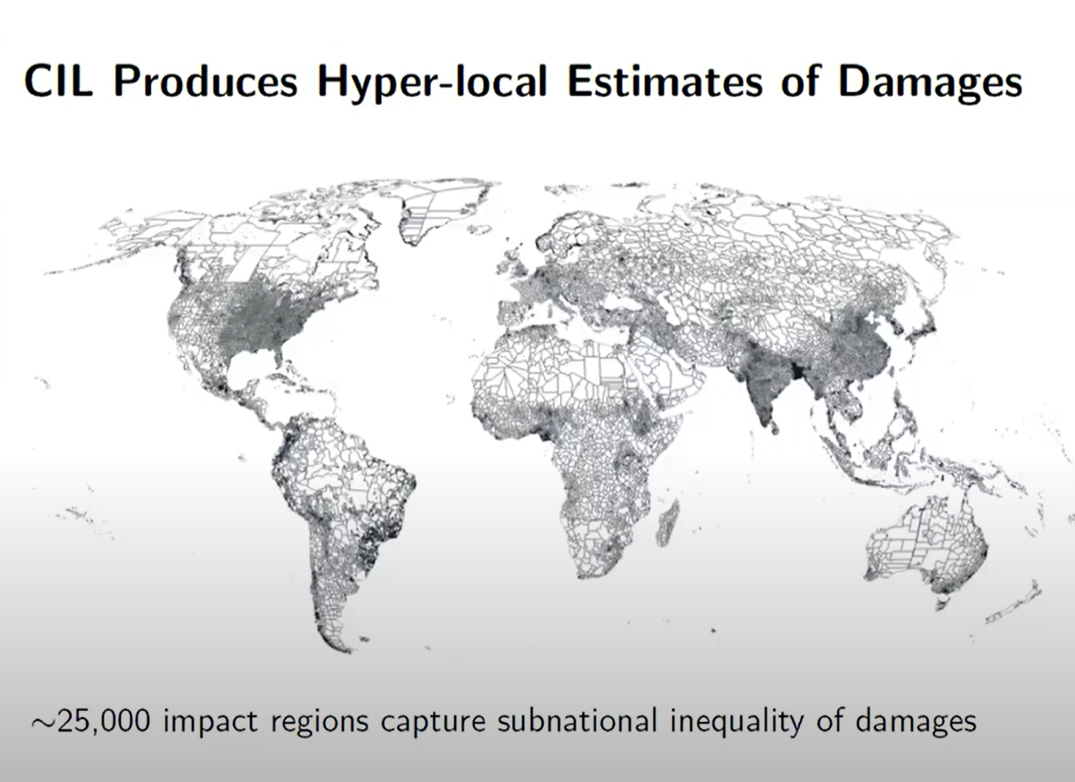

Slide 12
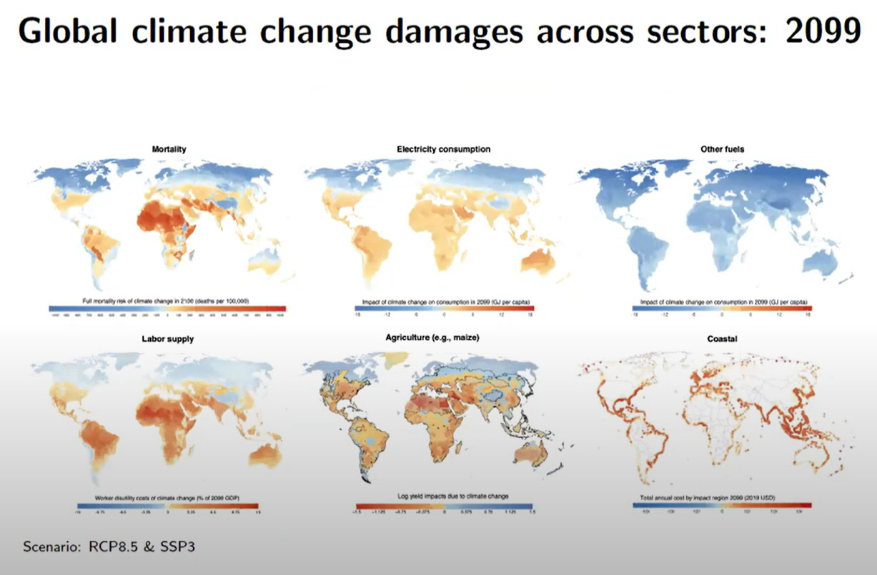

Slide 13
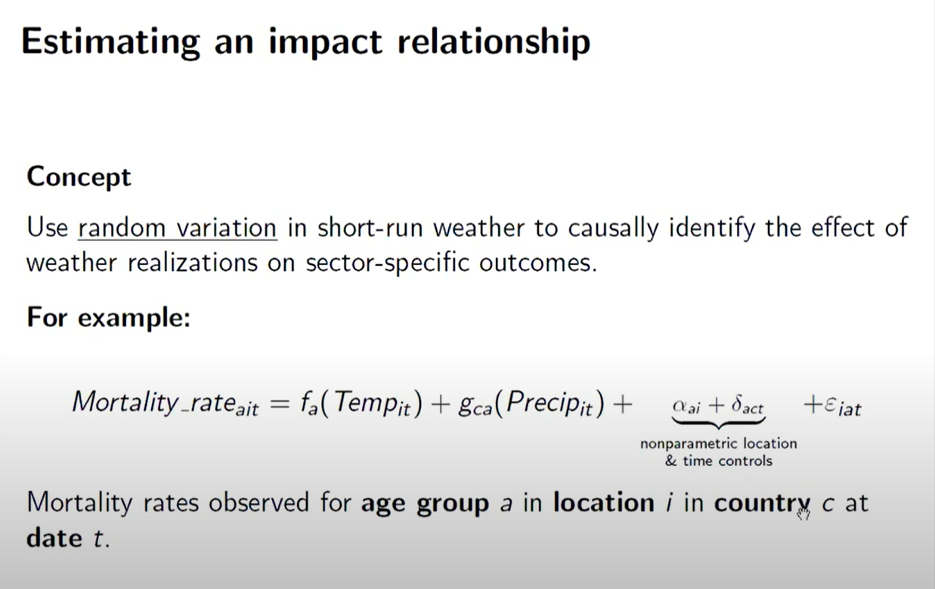

Slide 14
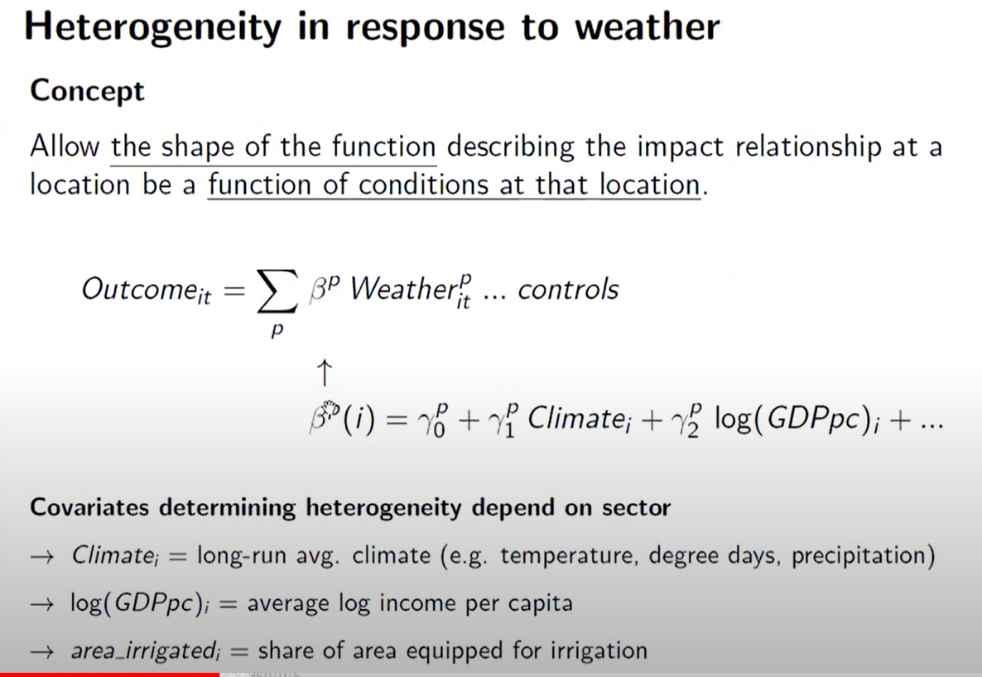

Slide 15
